Slide 1

STRATEGY & INNOVATION
Aishani Katyal Abhigya Asmi Pandey

Slide 2

INDEX
1
Executive Summary
6
Process of evaluation of New Investment Opportunities
2
Redesigning Financial Process
7
Key Performance Indicators
3
Emerging technologies and Implementation Roadmap
4
Fostering Culture of Innovation
5
Risk Management Strategy Dashboard Analysis

Slide 3
Executive Summary
XYZ Co.’s Treasury Office faces both internal and external challenges, including manual processes, siloed systems, volatile markets, and fragmented data. These issues hinder the Treasury’s ability to support the company’s strategic objectives, especially in a rapidly evolving tech industry. To address these challenges, XYZ Co.’s Treasury Office aims to undergo a strategic transformation focused on: Unlocking new growth opportunities, creating a competitive edge and empowering strategic decision-making through data-driven processes and real-time financial planning.
The Proposed Solution Revolutionizing the treasury office involves a comprehensive transformation aimed at integrating cutting-edge technologies and shifting towards data-driven, agile financial management processes. Central to this transformation is the adoption of AI-driven forecasting to replace manual forecasting methods. By incorporating blockchain technology, XYZ Co. can ensure real-time reporting, transparency, and compliance in its financial operations, making its treasury processes more secure and efficient. This shift is further enhanced by Robotic Process Automation (RPA), which automates routine tasks like payment reconciliations and data entry, allowing treasury staff to focus on higher-value, strategic initiatives. The KPIs will track metrics such as automation rates, cash flow forecast accuracy, ROI on investments, and operational efficiency, ensuring continuous improvement and alignment with strategic objectives.
Value
By implementing a robust risk management framework with key risk indicators (KRIs) and predictive models, XYZ Co. can mitigate potential financial threats more effectively. This reduces vulnerability to market volatility and geopolitical challenges, ultimately safeguarding the company’s financial stability. By minimizing manual errors and optimizing capital allocation, XYZ Co. can reduce operational costs while maximizing the return on its financial resources.
In summary, the value of the proposed solution for XYZ Co.'s Treasury Office lies in its ability to create a more efficient, strategic, and risk-aware treasury function that not only supports but actively drives the company's growth and competitive positioning in the market.

Slide 4
How should XYZ Co.'s Treasury Office redesign its financial planning processes to better support the company's strategic objectives and adapt to the fast-paced tech industry?
Internal Challenges
Manual Processes
External Challenges
Volatile Markets
Siloed Systems
Fragmented Data
Disconnected Workflows
Geopolitical Turmoil
Sophisticated Hackers
Expanding Scale
Current Challenges Faced at XYZ Co.'s Treasury Office
Challenges Faced by Corporate Treasury Teams Industry-Wide
65%
47%
45%
Struggle with File Formatting
Revolutionizing XYZ Co.'s Treasury
Agile Planning
Data Driven Decisions
Collaboration
Struggle with Onboarding
Struggle with Integration
Strategic Objectives of Transformation
Unlocking New Growth Opportunities
Creating a Competitive Edge
Empowering Strategic Decision-Making

Slide 5










Algorithmic investment tools to prioritize high-yield tech investments.
TREASURY REDESIGN
Manual Forecasting |  | AI-Driven Forecasting
Reactive Liquidity Management |  | Real Time Optimization
Reactive Risk Management |  | Predictive, Proactive Risk Management
Fragmented Strategic Planning |  | Growth Aligned Strategy
Conservative Investments |  | AI Driven Strategic Investment
Static Capital Allocation |  | Data-Driven & Dynamic Capital Allocation
Static Debt Management |  | Algorithmic Debt Optimization
Fixed Budget |  | Adaptive Rolling Forecasts
Manual FX & Interest Rate Mgmt. |  | Automated Hedging
Fragmented Financial Reporting |  | Real-time Reporting And Compliance (Using Blockchain Technology)
Real-time, predictive models enhance accuracy.
Automated tools improve cash visibility and utilization.
Real-time data and AI predict risks before they materialize.
Integrated planning aligns with innovation and expansion goals.
Algorithmic investment tools to prioritize high-yield tech investments
Real-time data informs agile capital distribution.
AI optimizes debt structure, minimizing costs
Continuous forecasts adapt to real-time changes.
AI-powered systems to dynamically adjust hedging strategies.
Blockchain ensures real-time reporting and compliance.

Slide 6
Identify and evaluate at least three emerging technologies that could significantly enhance the Treasury Office's operations. Propose an implementation roadmap for integrating these technologies into existing systems and processes.
1
2
3
AI and Machine Learning
Robotic Process Automation (RPA)
Blockchain Technology
Automates decision-making, optimizes cash forecasting and uses historical and real-time data to forecast future financial conditions
Automates repetitive, manual tasks such as payment reconciliations and data entry, freeing up resources for strategic functions.
Offers decentralized, tamper-proof financial transactions, ensuring transparency, security & real-time auditability.
Provides dynamic forecasting, rapid insights, and continuous process improvements.
RPA streamlines routine processes, enhancing operational efficiency and allowing the treasury team to focus on strategic, value-driven initiatives.
Increases transparency, improves security for payments, and reduces audit and reconciliation times.
4
5
Treasury Management System (TMS)
Cloud-Based Platforms
Centralizes treasury operations, providing real-time visibility into cash, liquidity, and risk. Integrates AI, RPA, and predictive analytics.
Real-time access to data, scalability, and enhanced collaboration for global treasury operations.
Provides real-time, agile management of treasury operations and easy integration with emerging technologies.
Enables rapid response to market changes, secure access, and seamless integration with other systems.

Slide 7
IMPLEMENTATION ROADMAP
Phase I
Phase II
Phase III
PILOT PROGRAM SETUP
PERFORMANCE MONITORING
PROCESS
REFINEMENT
RISK MGMT & KPIS
ASSESSMENT & FEASIBILITY
VALUATION
SYSTEM DEPLOYMENT
TECHNOLOGY INTEGRATION
=> Evaluate current financial systems.
=> Analyze costs, resource allocation for tech upgrades.
=> Determine ROI for each emerging technology.
=> Launch AI pilots for treasury analytics (e.g., Kyriba) and RPA for automation (e.g., UiPath).
=> Implement predictive analytics for cash forecasting (e.g., Alteryx).
=> Start transitioning treasury functions to cloud platforms (e.g., SAP S/4HANA).
=> Integrate AI for predictive analytics and cash forecasting.
=> Automate routine processes using RPA.
=> Refine processes and workflows for continuous improvement.
=> Implement blockchain for added security and transparency.
=> Establish KPIs for performance tracking.
=> Document and assess ongoing risk management protocols.
=> Select suitable TMS, AI, RPA solutions.
=> Conduct vendor comparisons and negotiate contracts.
=> Establish communication with internal teams for transition.
=> Train treasury staff on new systems and processes.
=> Continuously monitor system performance.
=> Optimize workflows based on real-time feedback.
0-3 Months
3-6 Months
6-9 Months

Slide 8

What specific actions can the Treasury Office take to foster a culture of innovation and encourage team members to embrace new ideas and technologies? How can the Treasury Office maintain this culture as it scales?
Most Sort After Attributes in a Treasurer
Actions to Foster a Culture of Innovation
1. Create Innovation Task Forces
84% say cross-functional collaboration drives innovation.
Form cross-functional teams to pilot AI, blockchain, and RPA initiatives.
2. Leverage Internal Incubation Labs
67% of companies with innovation labs adopt tech faster.
Set up treasury innovation labs for safe experimentation.
3. Promote Data-Driven Culture
Data-driven companies are 23x more likely to acquire new customers.
Implement AI for predictive cash forecasting and risk management.
4. Establish Continuous Learning
87% of employees engage more with tech-focused learning programs.
Create treasury-specific learning tracks on AI, blockchain, and RPA.
73%
Technological Affinity
Workforce that will guide their organizations into a digital future to support business intelligence.
Technological Affinity
84%
Business Partnering
Ability to collaborate with business units and leverage cross-functional relationships to provide strategic financial insights
Business Partnering
99%
Strategic Thinking Capabilities
Strategic Thinking
Capabilities
To enable the treasury’s shift
beyond daily cash and financial risk
management to a key corporate
strategic advisor.
Maintaining Innovation as Treasury Scales
Innovation KPIs: Tie individual performance to tech adoption.
(82% say this accelerates innovation)
CINO Leadership: Appoint a Chief Innovation Officer (CINO) to drive strategy. (60% saw improvements).
Open Innovation Ecosystem: Engage external partners to fuel innovation. (45% comes from partnerships).

Slide 9
Develop a comprehensive risk management strategy that incorporates predictive analytics and real-time data. How will this strategy enable the Treasury Office to anticipate and mitigate financial risks more effectively?
Identify Financial
Risk
Develop Mitigation Strategies
Implement Risk Controls
Monitor Risks
Assess Risk Impact
Identify potential financial risks that could impact the company by assessing Balance Sheet and Cash Flow historical data
Develop regression analysis and forecasting method, employ risk mitigation strategy such as hedging, credit derivatives and liquidity buffers.
Set up real time data updates, establishing key risk indicators, setting suitable threshold levels and running scenario analysis
Historical data to predict and validate accuracy of risk model, develop risk scoring metric and prioritize.
Regularly track KRIs and test models, document step by step approach on implementing risk mitigation strategies

Slide 10
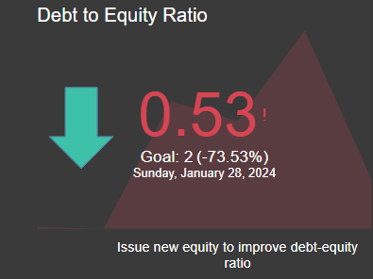
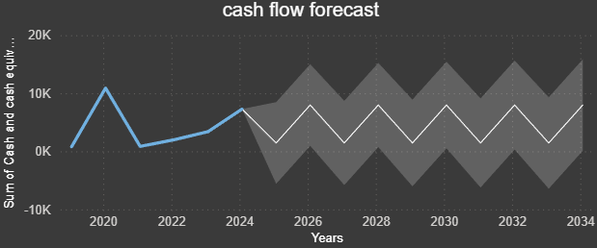
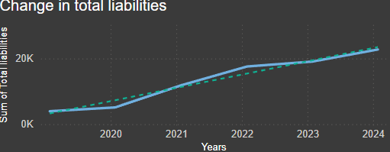
Regression Analysis
Utilized to understand relationships between financial variables (e.g., liabilities and income) and predict outcomes.
Forecasting Methods
Cash flow forecasting and trend analysis for predicting future financial health and stability.
Key Performance Indicators
Track critical financial metrics such as debt-to-equity ratio, current ratio, and EBITDA growth.
What If Scenario Analysis
Automatic Data Integration
Model different financial outcomes based on strategic decisions
Automate data feeds by using on premises data gateway in power BI to ensure up-to-date financial performance tracking.
1. Optimize Capital Structure
3. Cash Flow Forecasting and Liquidity Buffers
The debt-to-equity ratio of 0.53 suggests a relatively healthy balance, but with a targeted goal of 2, there's room to increase equity issuance to finance growth without significantly increasing debt risk.
Cashflow forecasts show fluctuations over time with some volatility in future years (2026 onward). Highlighting the importance of maintaining liquidity buffers and forecasting accurately.
Mitigation: Enhance cash flow forecasting accuracy by integrating advanced analytics tools
Mitigation: Issue new equity to improve the capital structure and provide flexibility for future investments, especially in high-growth opportunities. Monitor debt-to-equity to maintain the balance while reducing interest rate risks from rising debt levels.
2. Improve Liquidity Management
A current ratio of 4.78 indicates strong short-term liquidity, meaning the company has more than enough current assets to cover its liabilities. This high liquidity provides a cushion against any immediate financial risks but may suggest underutilized cash or overcapitalization.
4. Debt Management and Refinancing
Gradual increase in liabilities over the years (2020–2024) is not alarming but should be managed with a refinancing strategy to ensure that future debt can be secured at favorable rates.
Mitigation: Redistribute excess liquidity into higher-yield investments, ensuring the treasury manages liquidity to meet operational needs without holding excess idle cash. Use predictive analytics to forecast future cash needs more effectively.
Mitigation: Consider refinancing long-term debt when interest rates are favorable. Implement a debt maturity ladder to prevent a significant portion of liabilities coming due at the same time, reducing refinancing risk.

Slide 11
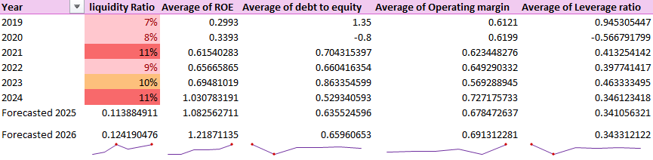
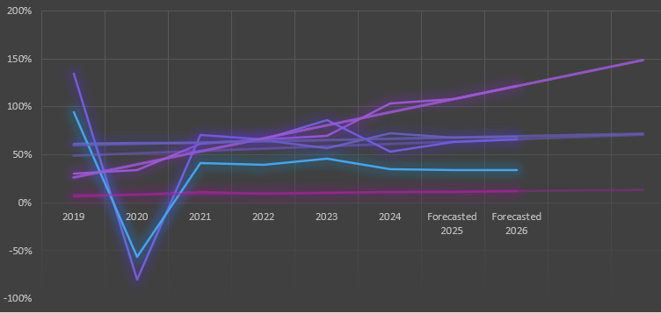
Forecasted Ratios
Improving Profitability & Efficiency
Capital Structure Optimization
Focus on Liquidity
The positive trend in ROE and operating margins shows XYZ Co.'s ability to enhance operational efficiency and generate more profit from its resources.
Investments should continue focusing on sectors or areas that are profitable and scalable.
The significant reduction in debt-to-equity and leverage ratios reflects XYZ Co.'s effort to lower financial risk and debt dependency. This reduction should be maintained or further improved to enhance financial stability, especially in uncertain economic conditions.
While there’s improvement in ROE and margins, the liquidity ratio remains a concern, especially its forecasted dip in 2025. Strategies should be adopted to bolster cash reserves or improve short-term asset management.
Leverage technology to streamline operations and improve productivity. Automation can reduce labor costs and increase production efficiency, which contributes to better operating margins.
Establish a clear policy for debt management, including setting limits on acceptable debt levels and prioritizing the repayment of high-interest debts. This ensures the capital structure remains healthy while maximizing growth opportunities.
Set aside a liquidity reserve (e.g., a certain percentage of profits) to cushion against unforeseen financial strains, ensuring that the company can meet its short-term obligations.

Slide 12
How can the Treasury Office contribute to XYZ Co.'s strategic growth by identifying and pursuing new investment opportunities? Outline the process for evaluating potential investments and ensuring they align with the company's long-term goals.
Indicative Business Case (IBC): It sets out the rationale for investment and outlines the list of options to meet the investment need for decision-makers to confirm and approve.
Single-stage Business Case (SSBC): If an investment is low-risk and funded from agency baselines, you can complete an (SSBC) instead.
Outline Rationale For Investment
Identify The Preferred Option
Follow the Budget process if new Crowd funding is needed to deliver your investment. At this stage you should have an approved DBC, and have been reporting your investment through Treasury’s Quarterly Investment Reporting.
The following roles are important to fill before continuing with the planning phase:
Senior Responsible Officer (SRO)
Governance authority
Project director or manager
Project team
Finalise The Delivery Plan
Risk Profile Assessment:
The investment must be included in Treasury’s quarterly reports to Ministers and Cabinet, and complete Gateway reviews.
Strategic Assessment: Outlines how the investment aligns with priorities, addresses a need, and supports required outcomes for Cabinet's initial decision.
Detailed Business Case (DBC): Provides an in-depth assessment of short-listed options and recommends the one offering the most public value, allowing Ministers and Cabinet to confirm the preferred option and delivery method.
Request for Proposals (RFP) Process: For investments requiring significant procurement, conduct an RFP to confirm delivery costs before final approval.
Implementation Business Case (IBC): Recommends the preferred supplier and seeks approval to enter a commercial contract, forming the foundation for the delivery phase’s Project or Program Management Plan.
Gather The Project Team
Consider The Options
Secure Funding

Slide 13
What key performance indicators (KPIs) should be established to measure the effectiveness of the Treasury Office's new strategic and innovative initiatives? Explain how these KPIs will be used to drive continuous improvement and support the company’s objectives.
Category | Key Performance Indicators (KPIs) | Purpose
Digital Transformation | Automation Rate: Percentage of processes automated Time to Decision: Average decision time for cash management | Improves operational efficiency and speed in decision making
Innovation | Innovation Adoption Rate: Percentage of teams using new tools No. of Innovation Projects: New initiatives launched | Fosters a culture of innovation and adapts to industry changes
Financial Performance | ROI on Treasury Investments: Returns on Investments Cost of Funds: Effective cost of capital raised | Enhances profitability and capital utilization
Risk Management | Cash Flow Forecast Accuracy: % deviation from actuals Hedging Effectiveness Ratio: Hedged vs unhedged exposure | Stabilizes cash flows and minimizes risks
Operational Efficiency | Treasury Expense Ratio: Operating costs as % of revenue Daily Cash Position Accuracy: Predictive Accuracy | Identifies efficiencies and optimizes cash management

Slide 14
THANKYOU!

Slide 15
References
https://www.pwc.be/en/news-publications/2023/global-treasury-survey-2023.html
https://pwc.com/gx/en/services/audit-assurance/publications/global-treasury-benchmarking-survey-2019.html
https://www.kyriba.com/solutions/enterprise/
https://www.gartner.com/en/industries/high-tech
https://trovata.io/blog/treasury-management-for-the-technology-industry/
https://www.cfo.com/news/working-capital-cash-accounts-payable-supplier-payments-credit-cards-invoices/694730/
https://blogs.opentext.com/its-time-to-modernize-corporate-treasury-departments/
https://www2.deloitte.com/content/dam/Deloitte/us/Documents/public-sector/Public-Sector-Treasury-Brochure.pdf
https://www.mckinsey.com/capabilities/strategy-and-corporate-finance/our-insights/five-steps-to-a-more-effective-global-treasury
https://www.bcg.com/publications/2024/bcg-treasury-benchmarking-survey-fortifying-the-balance-sheet

